Slide 1
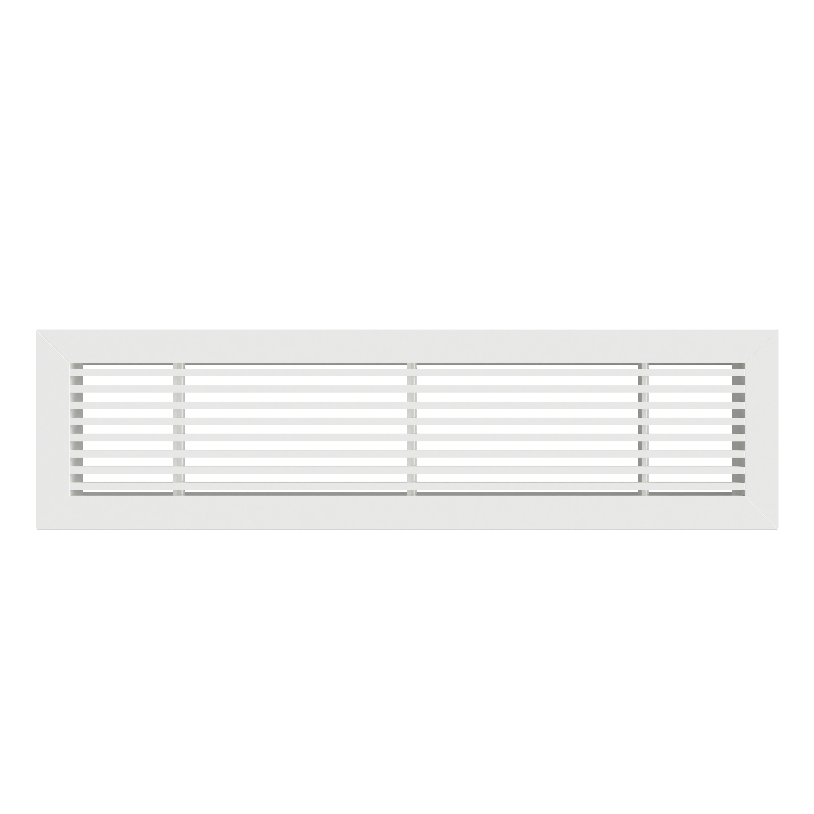
Air through perfection
Decorative grille
LB
Decorative linear grilles
www.acp.ro

Slide 2
Decorative grille
LB
Description
LB is a decorative linear aluminum grille used for introducing or evacuating air.
The grille is recommended for installations with constant or variable air flow.
LB can be applied to the ceiling or wall.
Technical specifications
Characteristics
The grille is available in two constructive variants:
LB-0 - with fixed blades at 0°
LB-15 - with fixed blades at 15°
The grille blades are fixed and parallel to the "L" (length).
For grilles with a length > 3m, the execution is modular, and the product is delivered together with the necessary connecting elements.
Depending on the overall position, the modular parts are built without termination elements or with a single element - see assembly sections.
As standard, the grille is manufactured with holes for screw mounting.
The product is delivered with fixing screws painted in the shade of the product.
Optionally, a mounting frame can be used for concealed mounting.
For installation with a mounting frame, the grille is accessorized with fixing clips.
Dimensional limits: Lint > 3m modular design, Hint max = 350 mm (standard).

Slide 3
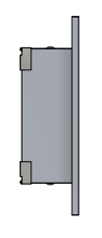
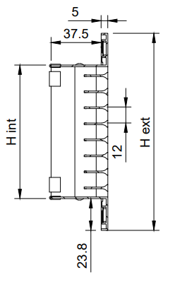
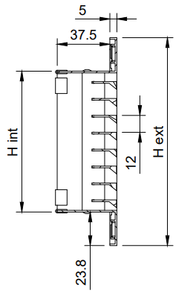
Technical drawing
Materials
The grille is made of extruded aluminum electrostatic field painted in glossy white RAL 9016.
On request, the grille can be made of natural anodized aluminum profiles or can be painted in other shades from the RAL palette.
LB-0
LB-15

Slide 4
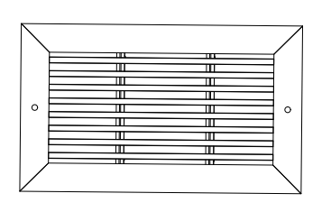
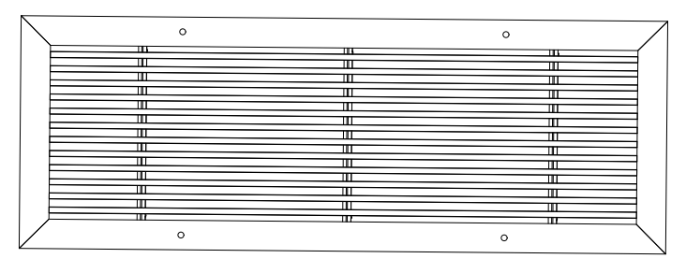
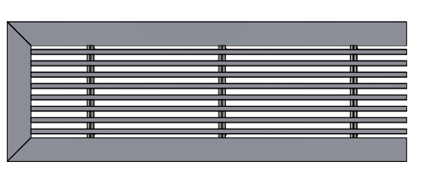
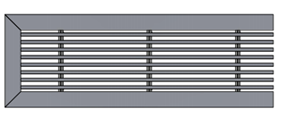
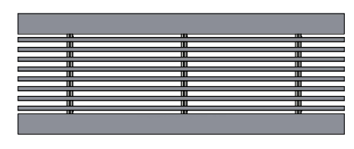
Product specifications
The grille is made standard with mounting holes positioned on the product frame. The number of holes and their position are made according to the size of the product, according to the pictures and table.
Section assembly
Large length grilles are made of modules with a maximum length of 3 m. In this case the product is delivered with connecting elements between modules.
S1
S3
S2

Slide 5
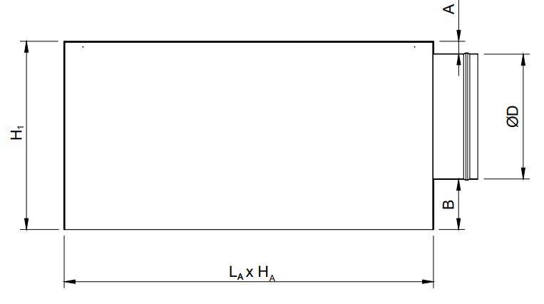
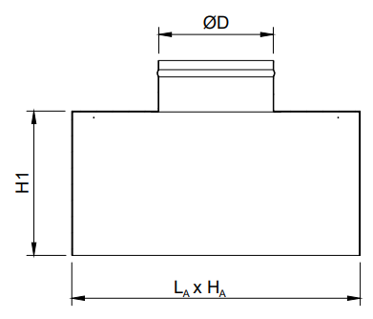
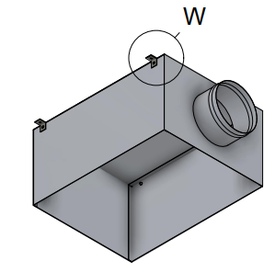
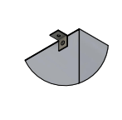
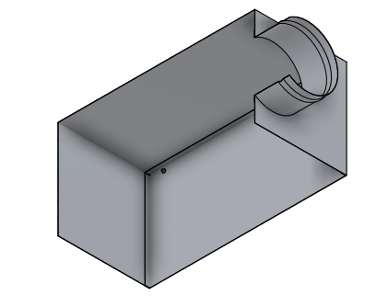
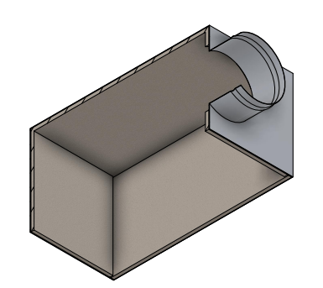
Accessories
The grille can be delivered with a connecting plenum to the circular duct, with horizontal or vertical connection.
The plenum is provided with suspension elements (lugs) and bead roll on the spigot, for easy fixing of the flexible duct.
The product can also be accessorized with opposed blade damper, G4 air filter or mounting frame.
Adapter (plenum box)
Horizontal connection (side/lateral exit)
Vertical connection (opposite exit)
* For fixing with screws: L_{A} X H_{A} = Lint x Hint grille + 5 mm
* For fixing with mounting frame: L_{A} X H_{A} = Lc x Hc mounting frame + 3 mm
A, B, H1 – depending on demand and ØD
The adapter is made of Z140 galvanized steel sheet and is equipped with suspension lugs.
W - Suspension lug
The plenum is available in two options, uninsulated or insulated with 6 mm thick elastomeric rubber.
AN - Uninsulated adapter
AIZ - Insulated adapter

Slide 6
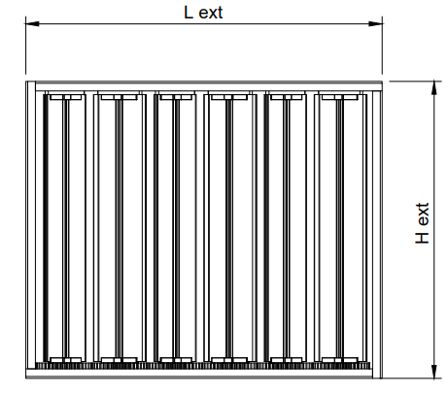
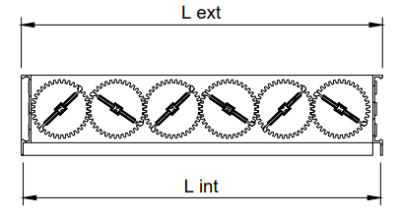
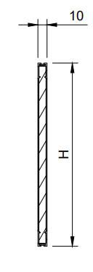
Opposed blade damper (OBD)
The damper is provided with opposable blades and gears, it is mounted on the grille connection.
Air filter G4 (F-R)
G4 air filter with aluminum frame is used for air filtration and is mounted on the grille connection.
The large dimensions are made in several pieces.

Slide 7
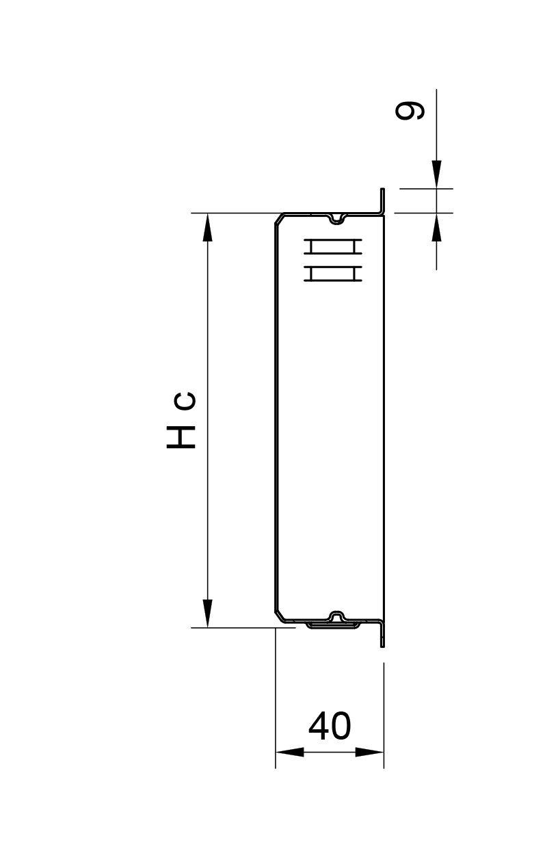
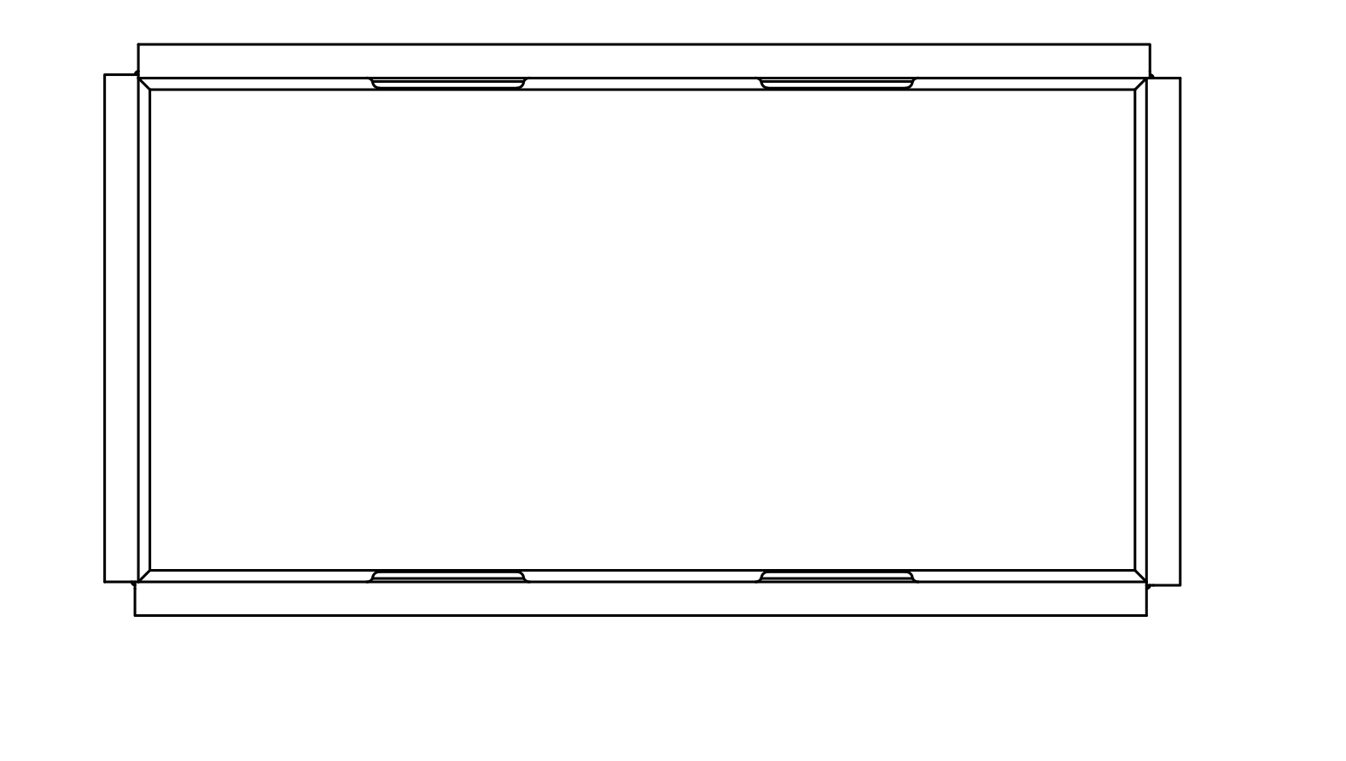
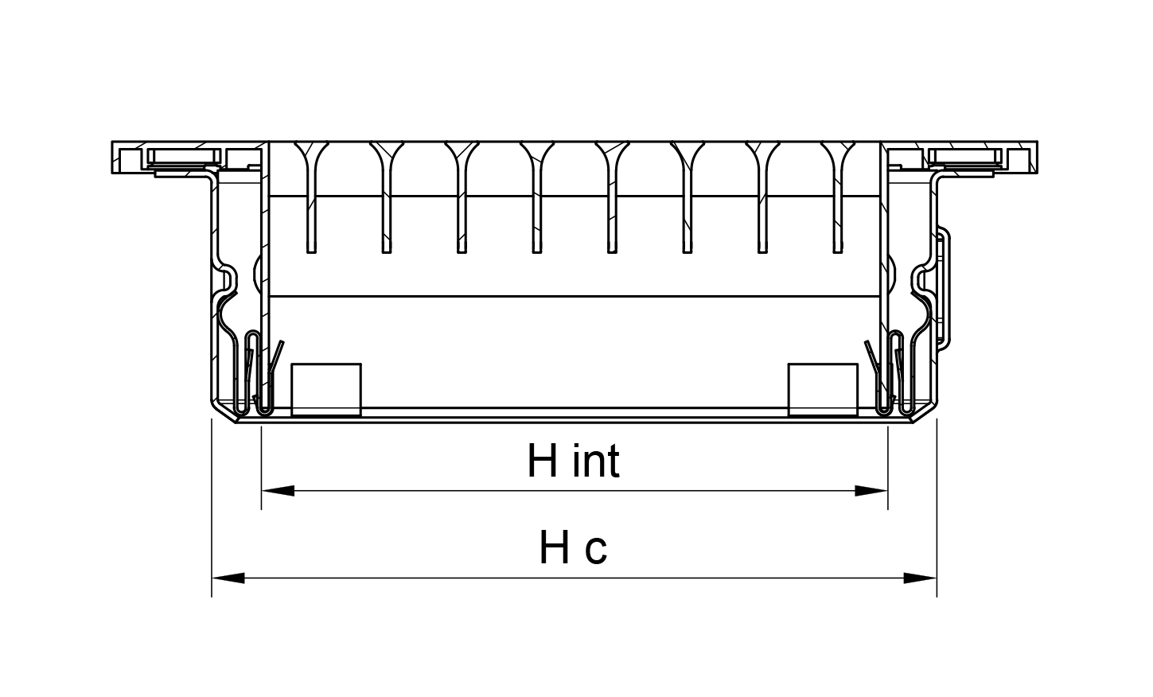
Mounting frame (CC)
The mounting frame is used when a hidden, easy and fast mounting of the grille is desired. Depending on the size required, it is made and delivered in one or more pieces.
For installation with mounting frame, the grille is equipped with clips that allow quick and easy clamping. The number of mounting clips that the grille is equipped depends on the size of the product.
Example: LB-0 + CC
Lc x Hc = Lint x Hint grille + 18 mm

Slide 8
Functional parameters
The legend
Ak [m²] - The free surface
X [m] - The length of the air jet at a speed of 0.2 m/s
NR [dB (A)] - Noise level without room attenuation
∆Pt [Pa] - Pressure loss
Veff [m/s] – Air velocity in the grille

Slide 9
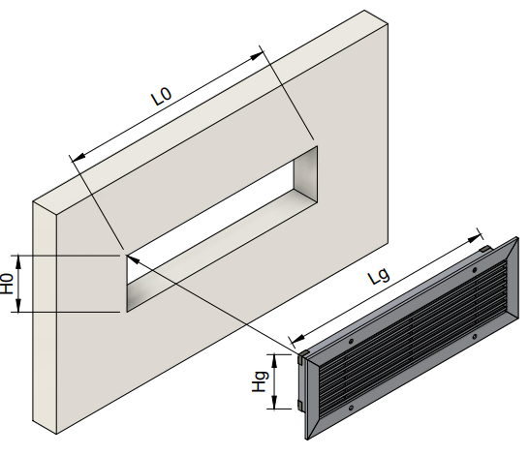
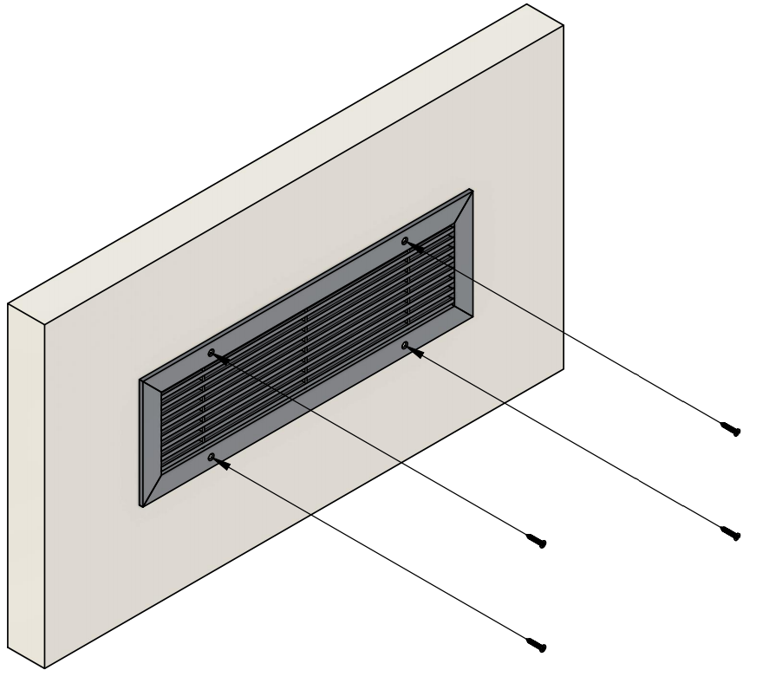
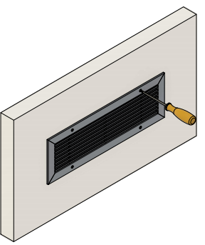
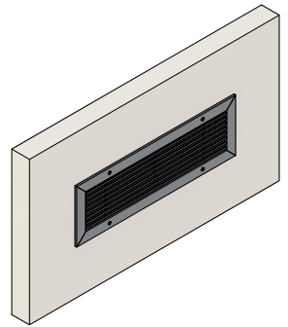
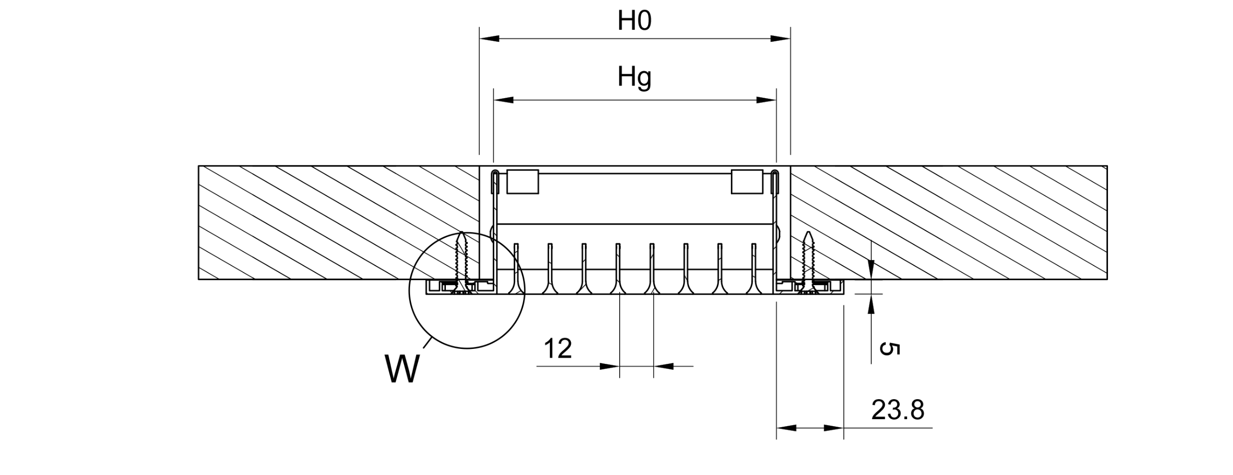
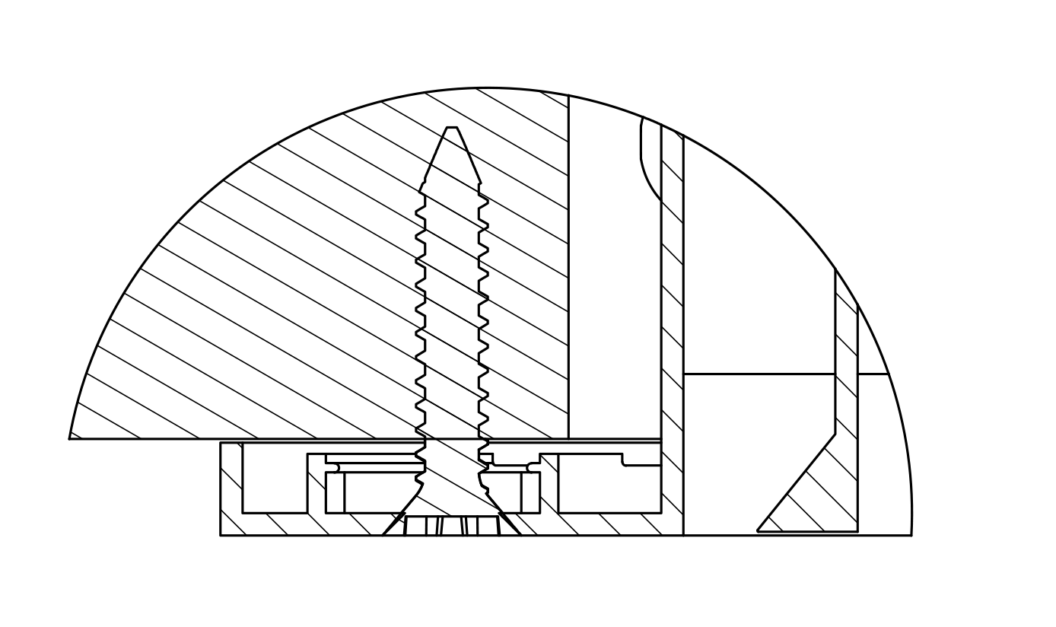
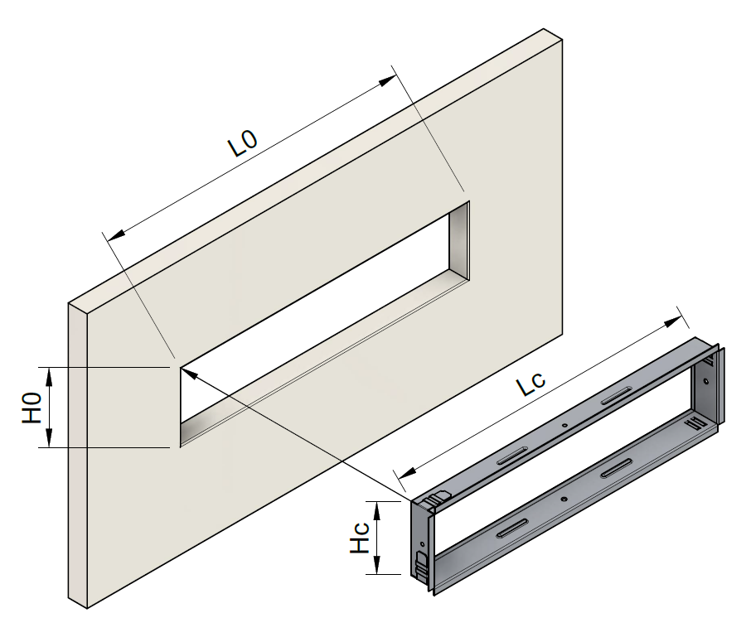
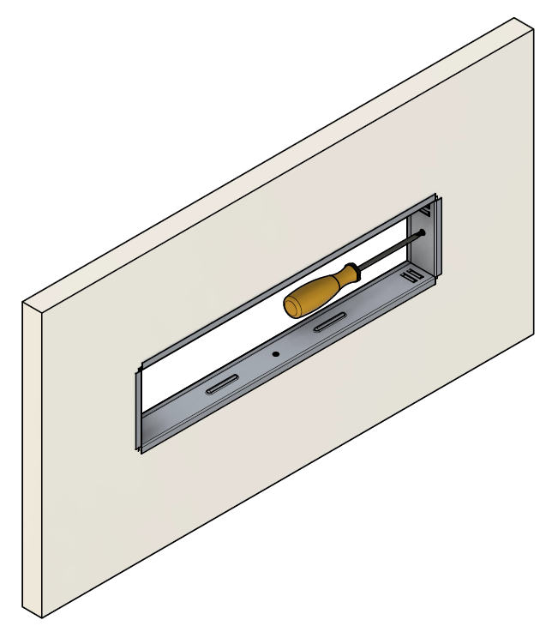
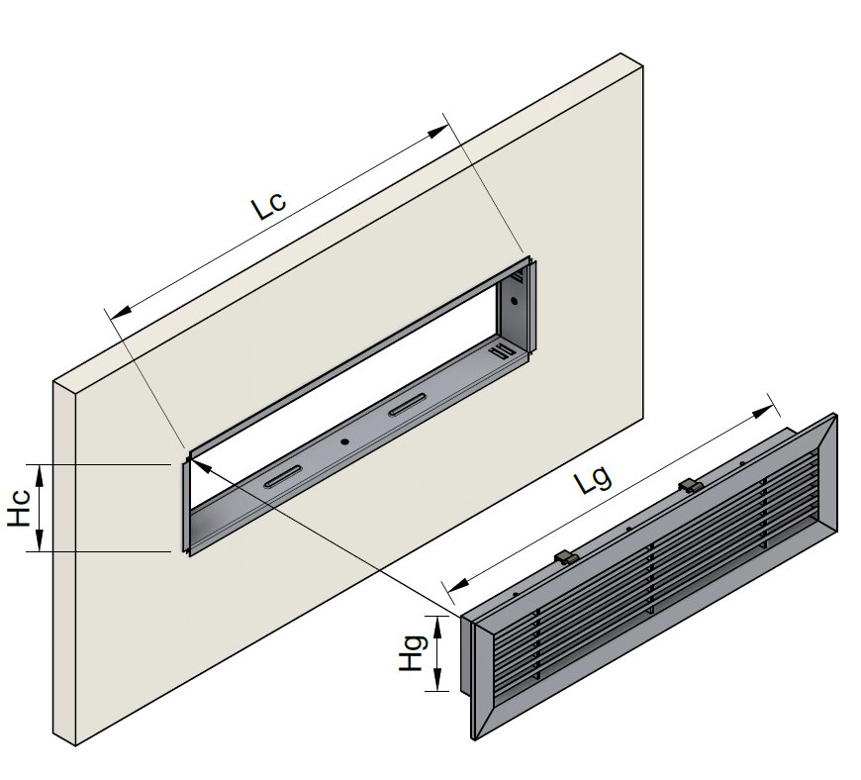
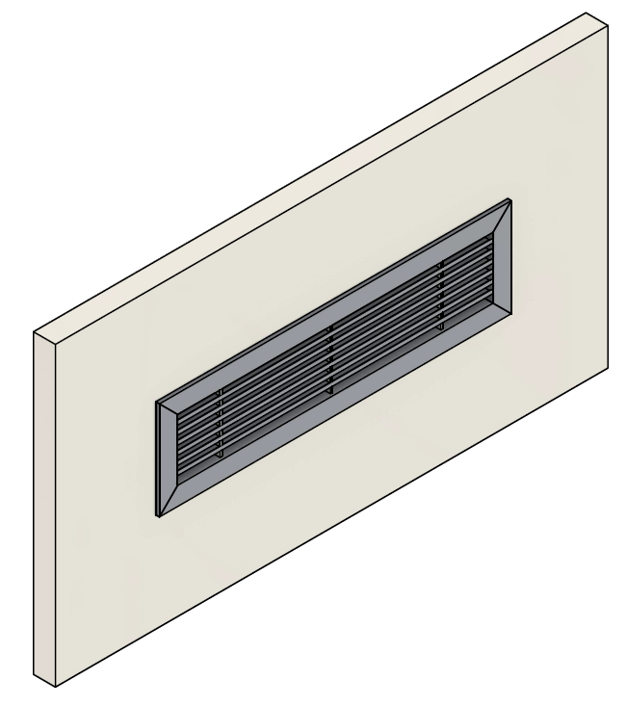
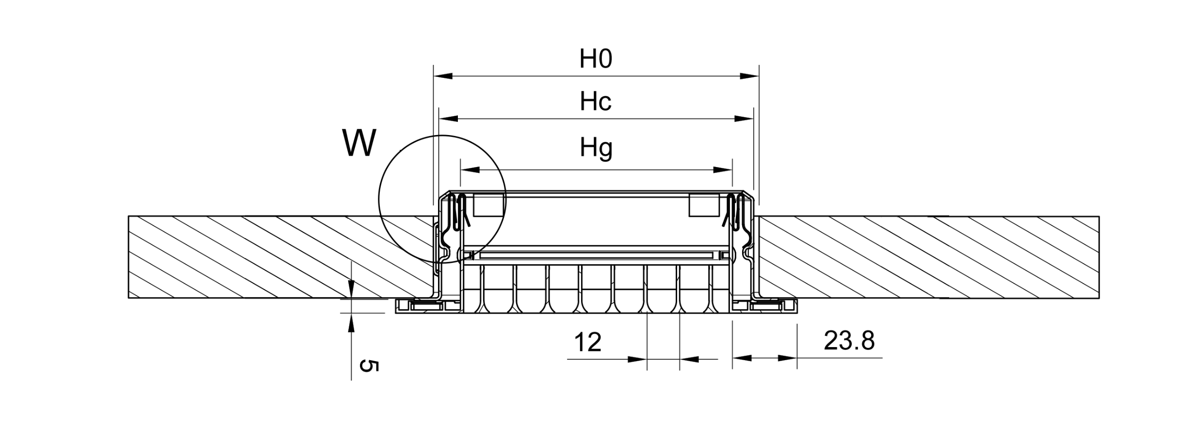
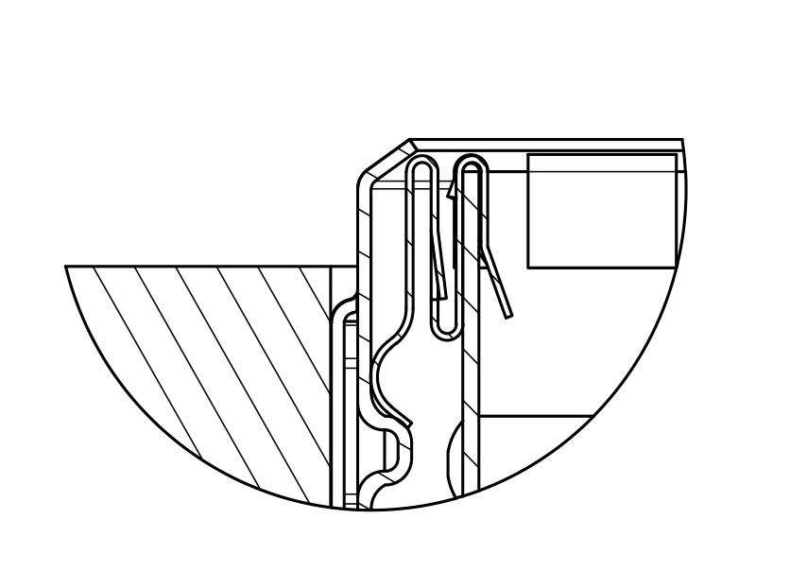
Installation As standard, the grille is mounted by screws. Optionally, for a hidden and easy assembly, a mounting frame can be used. The installation of the grille in the mounting frame is done by clamping.
Wall/ceiling mounting with screws
W
Wall/ceiling installation with mounting frame
W

Slide 10
Order code
Example on how to place an order

